Slide 1

P peline
The Data
How do we go from data set to question?
And from question to data set?
© Jennifer Mankoff
The Data Pipeline; HCII; Spring 2014

Slide 2
Goals
After this, you should be able to:
Understand the elements of the data pipeline as they played out in a case study
Be able to point to some pitfalls where things can go wrong in the data pipeline
Be able to explain how the question being answered affects the rest of the pipeline
Adapted from http://www.fordham.edu/economics/Vinod/correl-regr.ppt

Slide 3
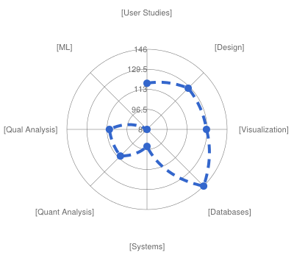

Slide 4
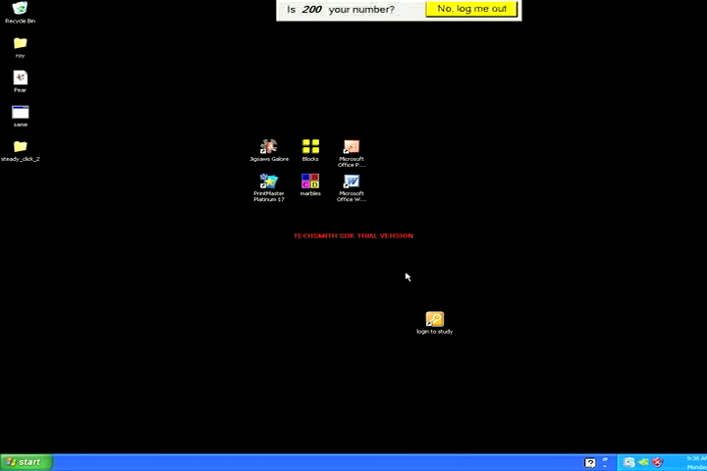
What can we do to reduce the impact of this problem?
Attempt to double-click desktop icon
Duration: 1 minute 40 seconds
Notes:
(PAUSE TO MAKE SURE VIDEOS PLAY) Here we see Annie attempting to activate a desktop icon. The video on the right shows her attempts to activate this desktop icon, and is unedited and lasts 1 minute, 40 seconds. The video on the left cycles through 3 clips that illustrate her two main pointing problems: slipping off a target (which she did 5 times) and difficulty smoothly moving the cursor making sporadic movements.
IF video doesn’t play go back to previous slide

Slide 5
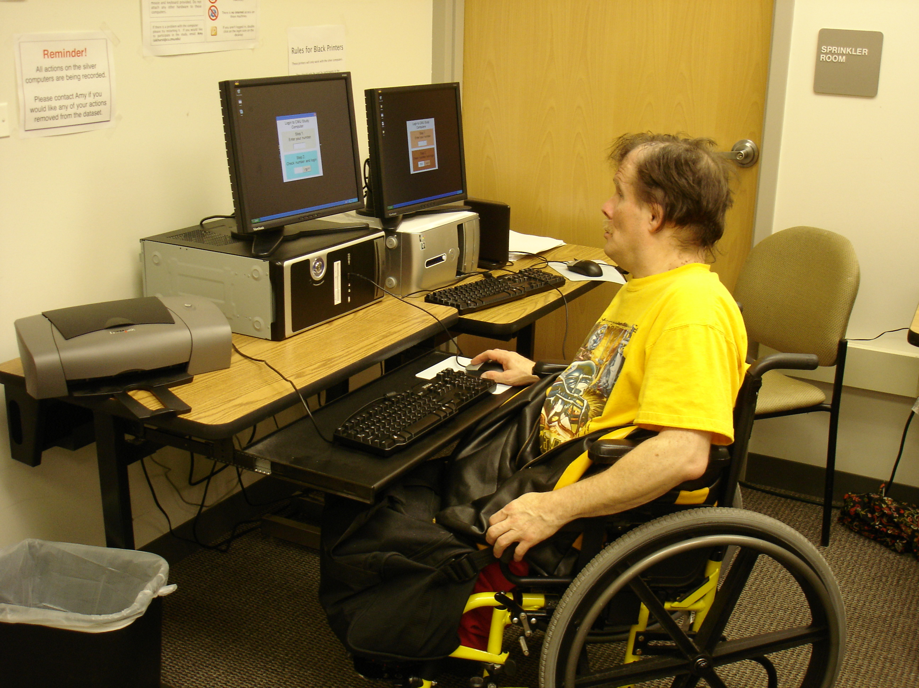
Large Real World Datasets
United Cerebral Palsy Pittsburgh
(08-10) 12 participants
Collected hundreds of hours of real world data from 27 people with and without pointing problems
Websurfing, socializing (email, instant messaging, social networking websites), homework, and video games
Both desktop and laptop usage
Notes:
Collected hundreds of hours of real world use from 27 people with and without pointing problems
We ran our pilot study at UCP Pittsburgh, and installed two desktop computers in a pre-existing computer lab. Participants were able to use these computers whenever they wanted (during a class or their free time) and perform any tasks they wanted. These computers are still collecting data at UCP, and for the first year of this study, they did not have internet access.
We recruited twelve participants with pointing problems due to motor and/or cognitive impairments for this pilot study

Slide 6
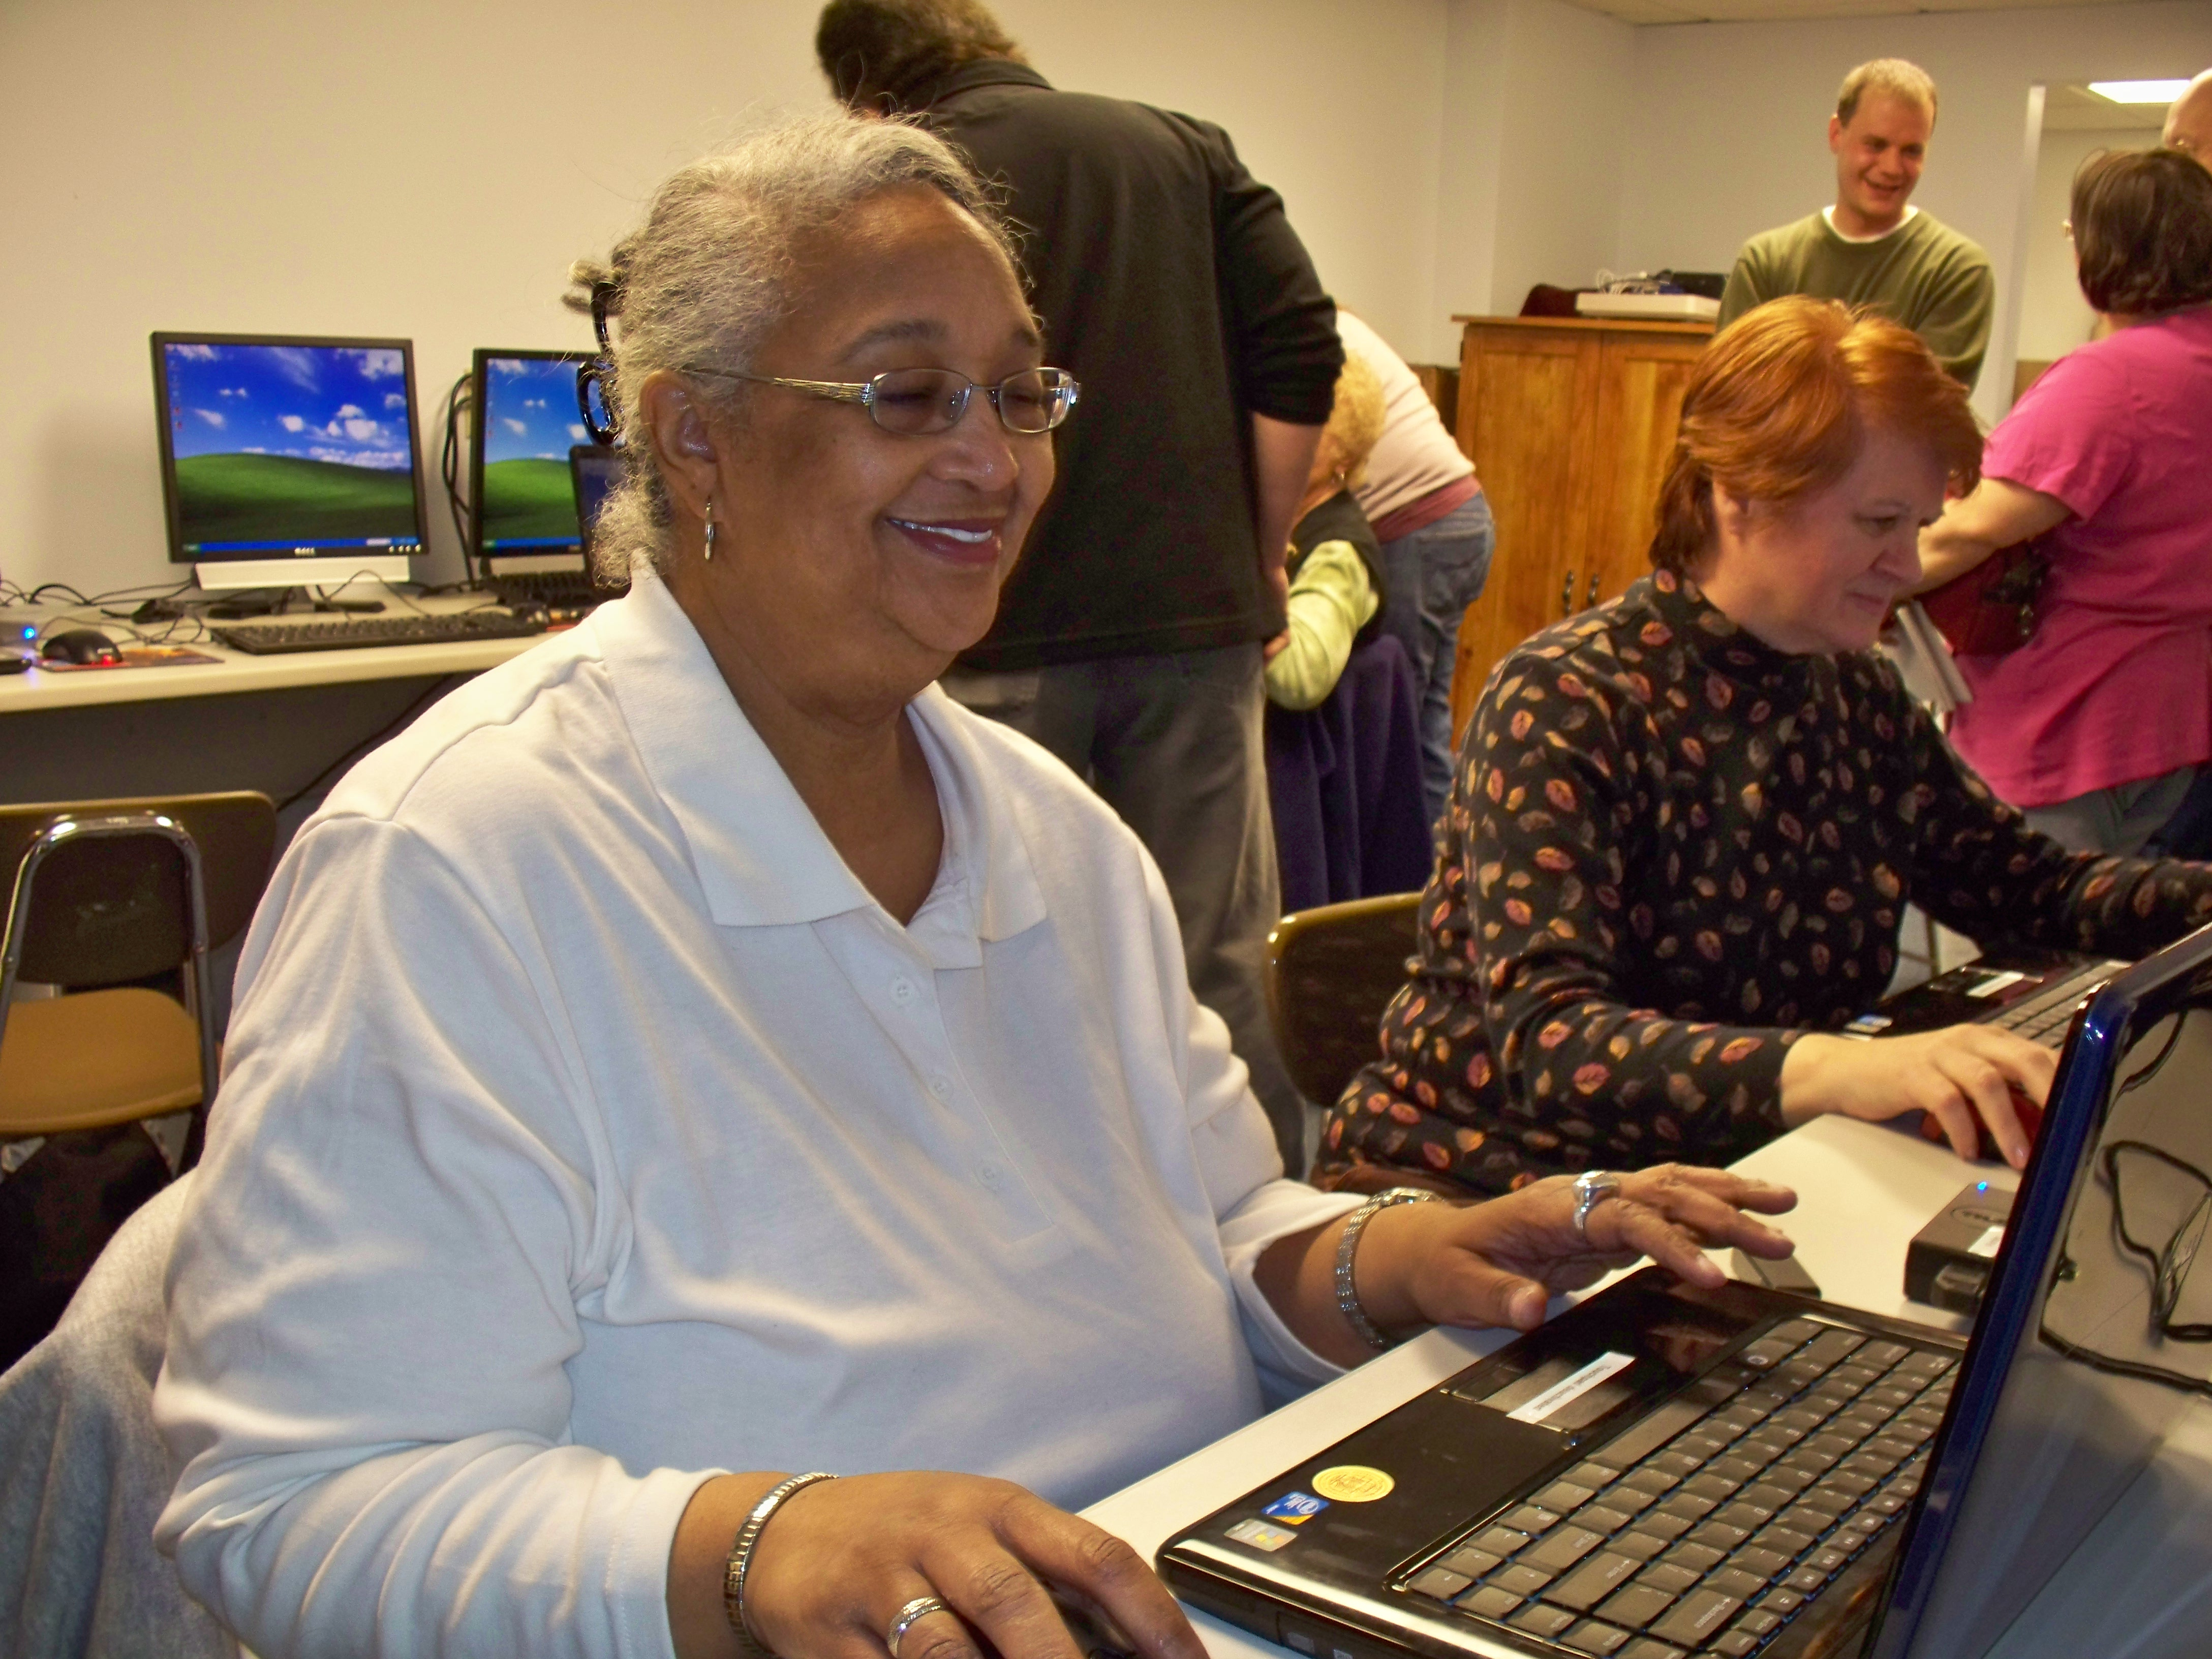
Laptop Deployment: Multiple Groups (July 09 – 10) 17 participants
 | Participants | Female | Average Age | % data collected
Able | 4 | 1 | 29.25 | 22.87%
Older Adult | 8 | 8 | 67.63 | 69.15%
Motor Impaired | 4 | 2 | 41.75 | 7.99%
Notes:
We have been collecting real world data using laptops for almost a year. In this study, we give our participants identical hardware: a DELL laptop with an external USB mouse. Participants who did not have access to the internet at home or work, received a wireless modem.
<click>
Our laptop deployment includes 4 individuals with motor impairments (2 of whom were also in our desktop study), 4 able bodied individuals (we recruited from CMU through a newsboard advertisement), and 8 older adults (a group of women who have known each other for years, are mostly computer novices, and meet monthly at Blueroof Technologies).
70% of the data we collected was from older adults – and most of this was game data (such as freecell, spider solitaire, mahjonng etc). Overall, over 50% of all data collected was from games, and 25% from Internet use.
----
Traumatic Brain Injury, occasional tremor
Cerebral Palsy, Spinal Cord Injury, Traumatic Brain Injury
Paralyzed from the waist down, memory and motor impairments (including an intermittent tremor).
Cerebral Palsy, arthritis, upper extremity impairment, cannot move right limb.

Slide 7
Our iterative process
Analysis & etc (not today’s focus)
Questions
Data Sets
New Questions
Can we characterize pointing problems?
Can we detect pointing problems?
Can we predict what technology will help?

Slide 8
Our iterative process
Analysis & etc (not today’s focus)
Questions
Data Sets
New Questions
Can we characterize pointing problems?
Year of real world data from people with & without pointing problems (and elders)
Can we detect pointing problems?
Can we predict what technology will help?
Lab data for people with and without AT

Slide 9
Our iterative process
Analysis & etc (not today’s focus)
Questions
Data Sets
New Questions
Can we characterize pointing problems?
Year of real world data from people with & without pointing problems (and elders)
Visualization of trensd within & across subjects
Can we detect pointing problems?
Statistical analysis (regression)
Can we predict what technology will help?
Lab data for people with and without AT
Supervised machine learning

Slide 10
Our iterative process
Analysis & etc (not today’s focus)
Questions
Data Sets
New Questions
Can we characterize pointing problems?
Year of real world data from people with & without pointing problems (and elders)
Can we predict task switches?
Can we predict click targets?
Can we detect pointing problems?
Can we improve targeting?
Can we predict what technology will help?
Lab data for people with and without AT
Can we detect routines?

Slide 11
Real World Data Set

Slide 12
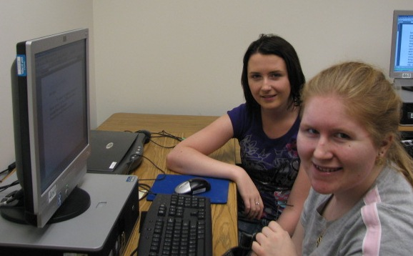
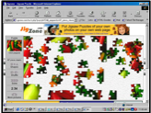
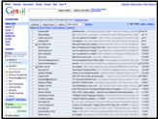
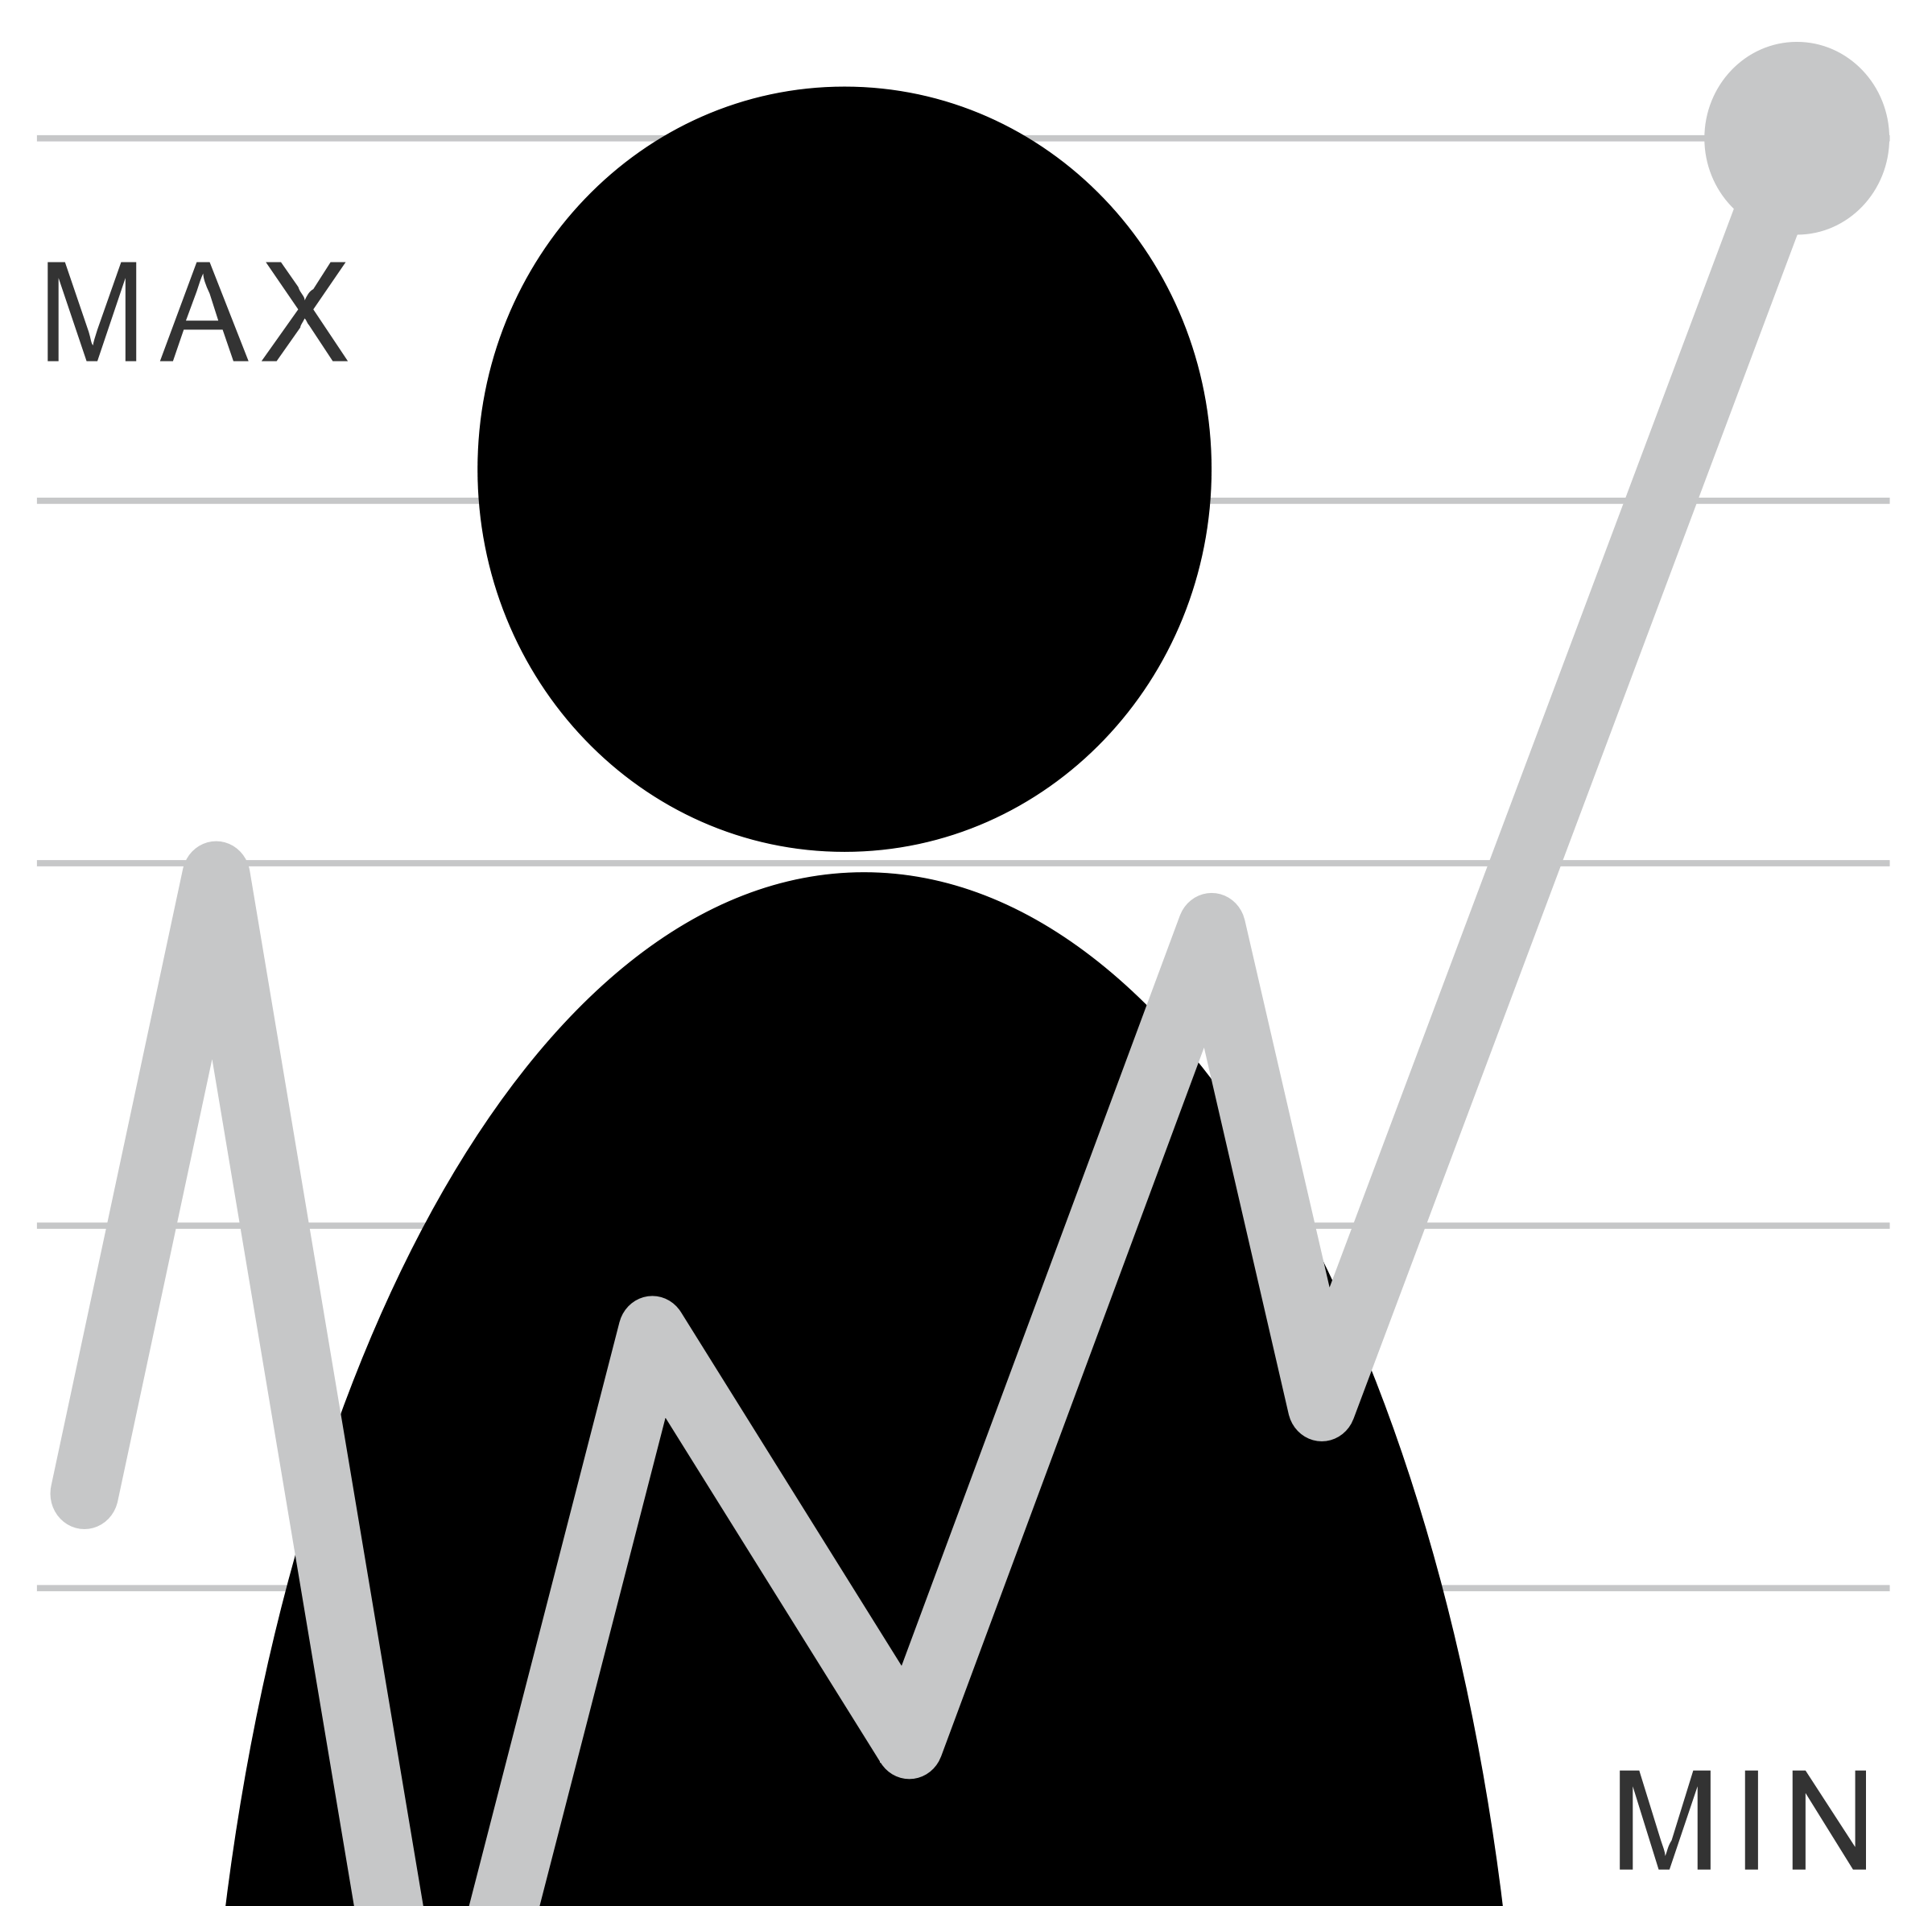
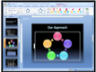
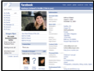
Human Issues in Data Collection
Unobtrusive logging software
Participant has full control over study logistics
Task
Collected information
Frequency and duration
Desktop and laptop use
Notes:
We use the following study design collect real world pointing data: We lend computers to our participants that run our unobtrusive logging software (will describe on the next slide). During our first meeting we perform a traditional laboratory clicking task, after that, participants have full control over all study logistics. They have the freedom to choose what they do with the computers, when the logging software is on, how frequently they use the computers, and they also get to decide the duration of any given session.

Slide 13
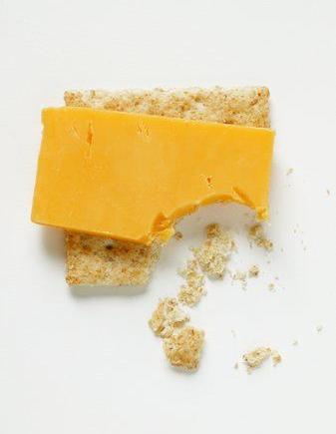
CRUMBS Logging Software
Capture Real-time User Mouse BehaviorS
Keyboard and pointer events
Window events
Target focus events from Accessibility API
Full-screen image captures on pointer events
Notes:
10 min
In order to unobtrusively capture real world pointing behavior across any application in Windows XP, we developed the CRUMBS logging software. CRUMBS captures ….

Slide 14
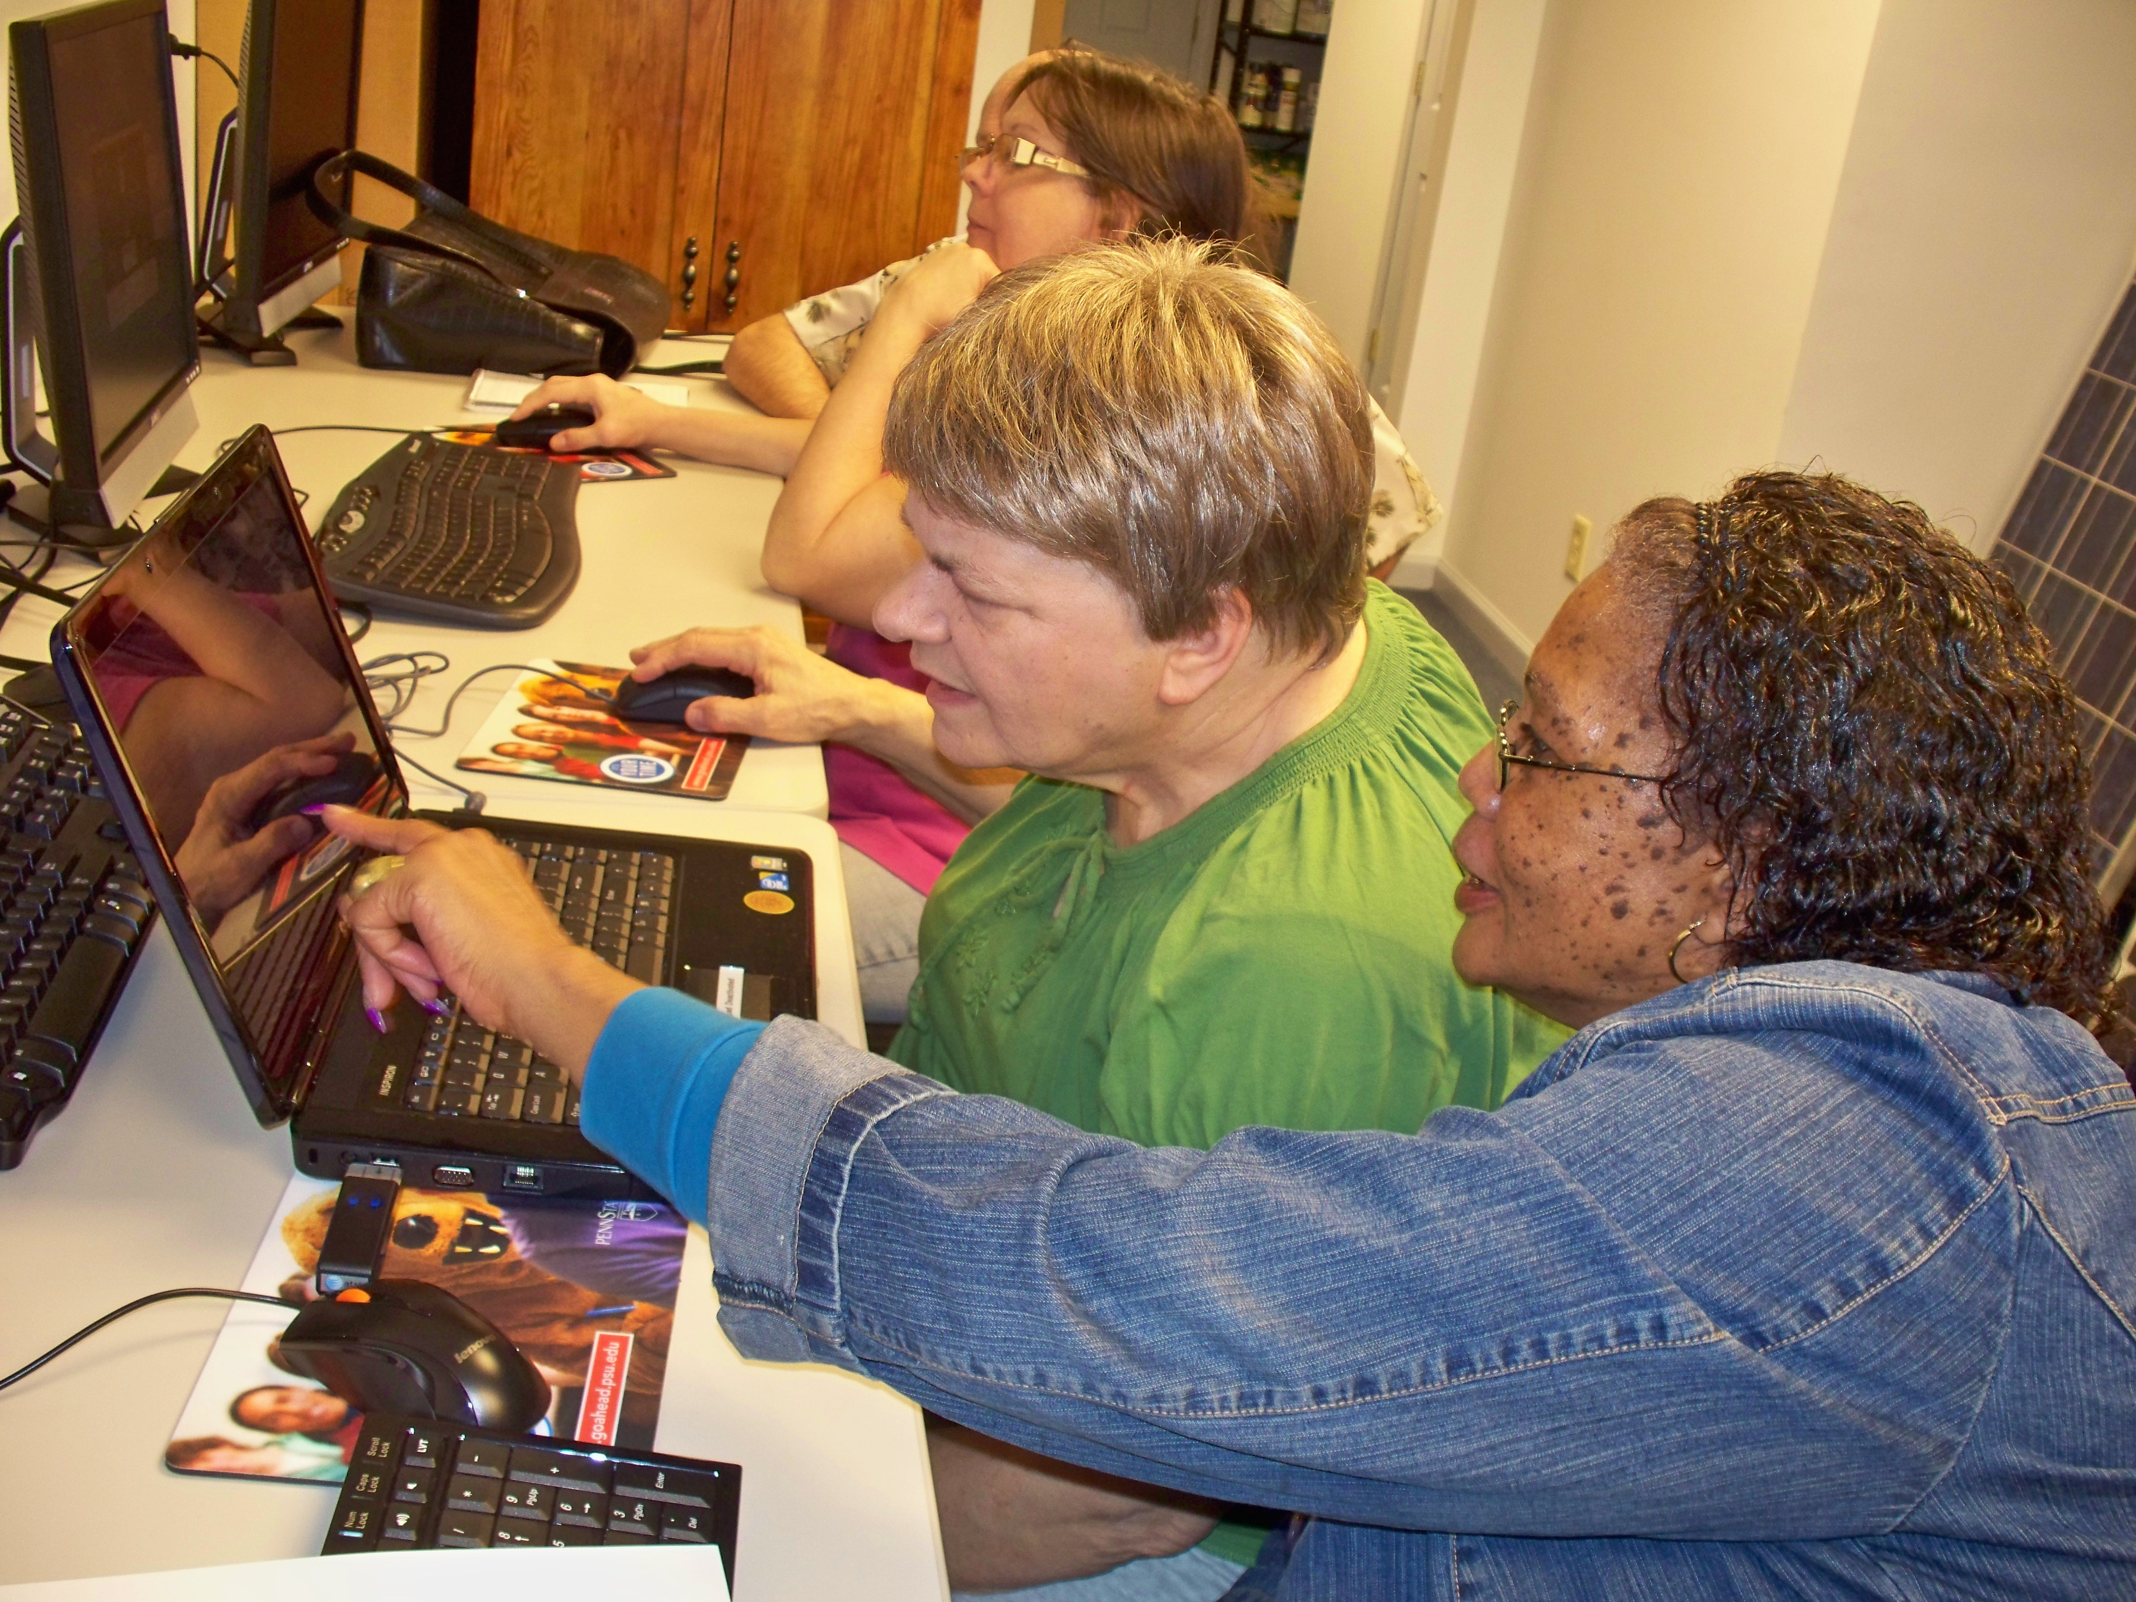
Group Support
Notes:
We found that our study protocol worked for all three populations. We believe that this protocol worked particularly well for our older adults and motor impaired participants because they had external support.
The older adults in our study frequently worked together and taught each other how to use the computers (both during their monthly meetings at Blueroof and outside these meetings).
Our motor impaired participants at UCP received support from the staff there who would help them set up the laptops, and allowed them to use their laptops during classes.

Slide 15
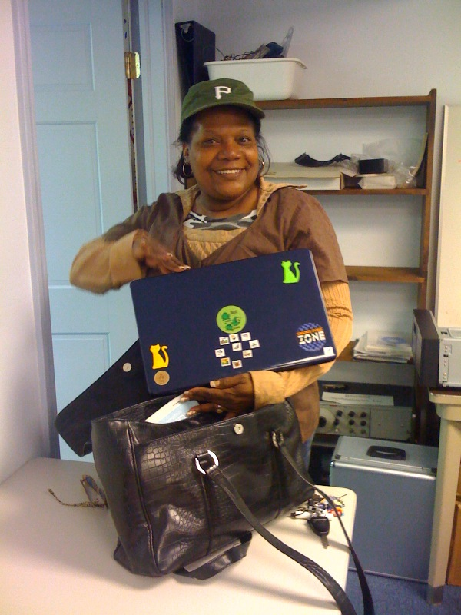
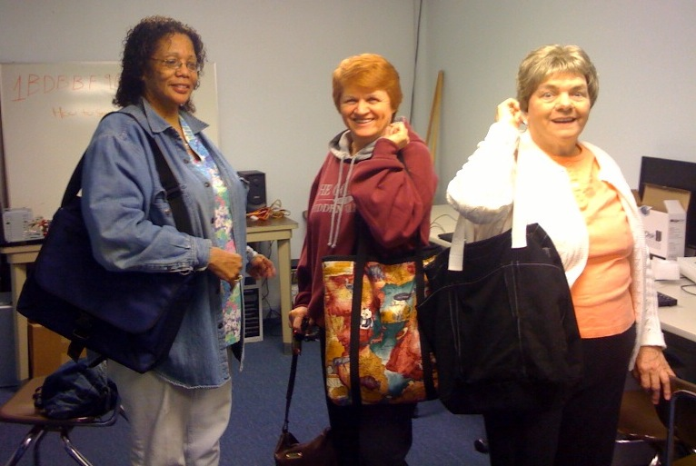
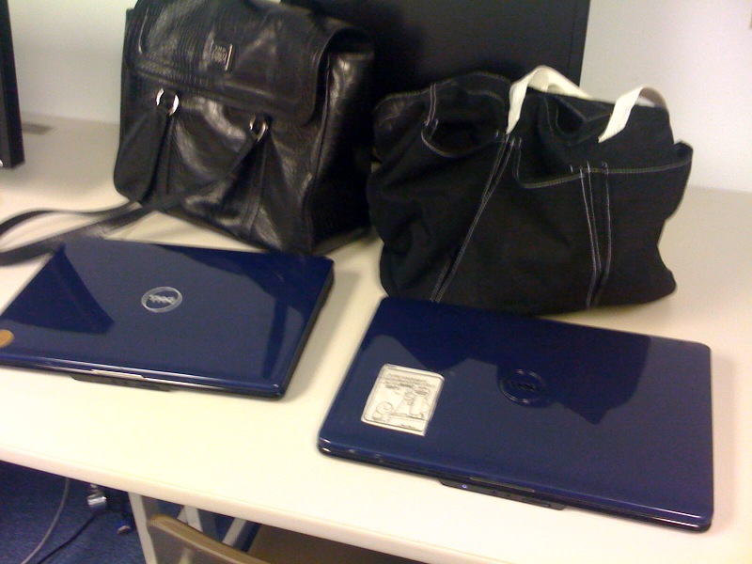
Attachment and Personalization
Notes:
In general, participants were pretty enthusiastic about being in this study – likely because they were excited to have access to a laptop. We also we found our participants used these laptops as if they were their own: they decorated them, and carried them around in unique bags.
I really enjoyed conducting this study because I got to see how much of a positive impact these laptops had on our participants lives, and watch many of our participants learn how to use computers.

Slide 16
Could we answer the first set of questions?

Slide 17
Data Tables
One-time & Qualitative data about participants (participant number; ‘diagnosis’; performance on initial test; etc)
Session data (summary)
Event data (details)
Segment data (summary)
Keyboard key down (if any)?
Mouse features
Target features
…

Slide 18
Unlike laboratory data,
real world data is not easily segmented by task
Notes:
Analyzing real world data is more complicated than analyzing laboratory data. One reason is that laboratory log data is typically “segmented” by task (or intent) which is usually clear because the experimenter tells the participant what to do. However, when studying real world data, we do not know the user’s tasks and the only information we have to work with are long logs of event data.
Since we don’t know intent, we segment data according to events captured by CRUMBS that are relevant to the assessments we want to make. In this thesis we focus on targeting motions, so we segment data by button events and pauses.

Slide 19
Also there are lots of anomalies
Notes:
Removed samples with more than 10 minutes of pause data
Removed windows and targets that were larger than 2000 pixels

Slide 20
And unexpected differences that made analysis difficult
Notes:
Application popularity differed a lot from group to group

Slide 21
Carefully chosen metrics helped
Do the velocity values match your understanding of the units?
Do they match past work? Keates (2005): Able ~112; Older 271; Motor 316
 | Game |  | Internet |  | MS Office
 | Mean (ms) | SD | Mean (ms) | SD | Mean (ms) | SD
Able |  |  | 147.236 | 15.912 | 128.526 | 10.1733
Older | 226.845 | 72.801 | 221.076 | 63.239 | 163.282 | 30.4858
UCP | 406.756 | 285.245 | 391.059 | 128.410 | 290.252 | 74.4451
Notes:
Example scripts to address each of these?

Slide 22
Carefully chosen metrics helped
Clicking, targeting, and movement metrics quantify pointing performance
Metrics drawn from previous laboratory evaluations of pointing data
ISO Ergonomic requirements for office work with visual display terminal 1998
Mackenzie et al. 2001
Ketcham et al. 2001
Keates et al. 2002 and Keates et al. 2005
Trewin et al. 2006
Notes:
Once data has been segmented, we can calculate performance metrics – which quantify the pointing action. Examples of metrics I calculate include movement velocity, number of direction changes during movement, and distance slipped during a button press.
There are literally decades of HCI studies of pointing behavior in the lab, and many metrics have been developed to measure different aspects of motion. In our analysis, we chose to investigate metrics that had been previously used in laboratory studies to measure clicking and movement problems of older adults and individuals with motor impairments.

Slide 23
Characterizing Performance: Slipping
Notes:
User unintentionally moves cursor while button is pressed [Trewin et al. 2006]

Slide 24
Characterizing Performance: Velocity
Notes:
User unintentionally moves cursor while button is pressed [Trewin et al. 2006]

Slide 25
Characterizing Performance: Throughput
Movement speed, independent of target size and distance to target [ISO 9241-9 1998]

Slide 26
Our iterative process
Questions
Data Sets
✔
Can we characterize pointing problems?
Year of real world data from people with & without pointing problems (and elders)
Can we detect pointing problems?
Can we predict what technology will help?
Lab data for people with and without AT

Slide 27
Summary of Laptop Findings
Motor impaired had “lowest” performance and able bodied had “highest” performance
Slipping frequency, click duration, X and Y direction changes (by ID), velocity and peak velocity
Games popular for older adults and motor impaired participants
These participants had shorter click duration and higher velocity and peak velocity during games than other tasks
Notes:
To summarize our laptop findings:
We found that motor impaired participants had “lowest” performance and able bodied participants had the “highest” across the following features. These findings are consistent with prior work.
We don’t know exactly why older adults and motor impaired participants showed better performance during game play. This may be due to higher motivation, engagement, or confidence about the next action.

Slide 28
Detecting Pointing Problems
Limited to Office and Internet data (common to all groups)
Generated 77 features
Pointer features: clicking and movement
Target sizes
Keyboard and window event features
Two-level predictive model distinguishes between groups @ ~90-92% accuracy
Able bodied (AB) (few pointing problems)
Older adults (OA) and participants with motor impairments (MI) (more pointing problems)
Notes:
We used our real world data from our laptop deployment to assess real world use.
We used Internet and Microsoft office data to build predictive models that distinguished between two performance groups: able bodied participants, and motor impaired and older adults. We distinguish between these groups using a two level model where the first level is a two way classifier between these two groups, and makes a prediction based on one motion sample. The second level uses a windowed average to make predictions over a series of samples.
These predictive models were built using only Internet and Microsoft Office data (because CRUMBS was unable to retrieve the size and location of many of the targets in games). Using this data we generated over 70 features (using both click and pause segmentation techniques)…

Slide 29
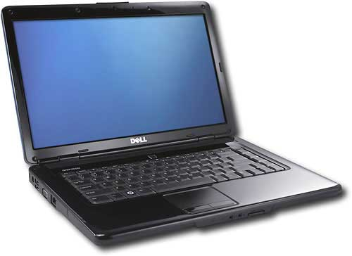
Level 2: Windowed Results
Notes:
The first level of our classifier predicted which group performed a given movement sample. The second level of our classifier aggregated successive predictions over several movements. This is known as a “sliding window”.
Are you convinced? We’ll talk later about issues with this – from the machine learning to the fact that we had such a simplistic cut to the lack of a real world deployment
Specifically, we aggregated predictions from a variety of window sizes (1, 5,10, 20, 40, 80,160, 320 samples) and used a voting model to classify predictions of able-bodied vs. OA or MI use.
Using this sliding window increased accuracy by 5% with a window size of 5. As we increased the window size, we got better estimates. Given that we are studying real world use, it is relatively easy for us to collect dozens or hundreds of examples of use to use for these windows.
Note that as we increase our window size, we require more samples before we can make our first prediction. Additionally, there is a diminishing returns effect where adding more samples provides a smaller improvement to accuracy.

Slide 30
Our iterative process
Questions
Data Sets
✔
Can we characterize pointing problems?
Year of real world data from people with & without pointing problems (and elders)
?
Can we detect pointing problems?
Can we predict what technology will help?
Lab data for people with and without AT
Notes:
Are you

Slide 31
New Questions?

Slide 32
New Questions
Questions
Data Sets
New Questions
✔
Can we characterize pointing problems?
Year of real world data from people with & without pointing problems (and elders)
Can we predict task switches?
Can we predict click targets?
?
Can we detect pointing problems?
Can we improve targeting?
Can we predict what technology will help?
Lab data for people with and without AT
Can we detect routines?
Notes:
Are you

Slide 33
New Questions
Questions
Data Sets
New Questions
✔
Can we characterize pointing problems?
Year of real world data from people with & without pointing problems (and elders)
Can we predict task switches?
Can we predict click targets?
?
Can we detect pointing problems?
Can we improve targeting?
Can we predict what technology will help?
Lab data for people with and without AT
Can we detect routines?
Notes:
Are you

Slide 34
New Questions
Questions
Data Sets
New Questions
✔
Can we characterize pointing problems?
Year of real world data from people with & without pointing problems (and elders)
Can we predict task switches?
✘
Can we predict click targets?
?
Can we detect pointing problems?
Can we improve targeting?
Can we predict what technology will help?
Lab data for people with and without AT
Can we detect routines?
Notes:
Are you

Slide 35
New Questions
Questions
Data Sets
New Questions
✔
Can we characterize pointing problems?
Year of real world data from people with & without pointing problems (and elders)
Can we predict task switches?
✘
Can we predict click targets?
?
Can we detect pointing problems?
Can we improve targeting?
Can we predict what technology will help?
Lab data for people with and without AT
Can we detect routines?
?
Notes:
Are you

Slide 36
New Questions
Questions
Data Sets
New Questions
✔
Can we characterize pointing problems?
Year of real world data from people with & without pointing problems (and elders)
Can we predict task switches?
✘
Can we predict click targets?
✘
?
Can we detect pointing problems?
Can we improve targeting?
Can we predict what technology will help?
Lab data for people with and without AT
Can we detect routines?
?
Notes:
Are you

Slide 37
User Error: Helping People with Motor Impairments
Click location not always equal to intent
Model click as PMF
Re-ran to see new outcome for 4 people
Notes:
Demonstration of broad applicability of tool.
Taking same capability, using for something new. For people who have difficulty with pointing. Pointing position doesn’t accurately reflect intent.
Treat this as a new form of uncertainty.
To test this idea, we collected 419 clicks from 4 people with motor impairments
We used our framework to determing what would happen if their input was handled probabilistically. As you can see, error drops significantly when compared to conventional input.

Slide 38
User Error: Helping People with Motor Impairments
Well we could have … but it was easier to run 4 new people on known targets! One big reason: Otherwise we didn’t have all the distractor targets.
Click location not always equal to intent
Model click as PMF
Re-ran to see new outcome for 4 people
Notes:
Demonstration of broad applicability of tool.
Taking same capability, using for something new. For people who have difficulty with pointing. Pointing position doesn’t accurately reflect intent.
Treat this as a new form of uncertainty.
To test this idea, we collected 419 clicks from 4 people with motor impairments
We used our framework to determing what would happen if their input was handled probabilistically. As you can see, error drops significantly when compared to conventional input.

Slide 39
It’s difficult to collect the right data (and to use other people’s data in ways they didn’t intend)
Questions
Data Sets
New Questions
✔
Can we characterize pointing problems?
Year of real world data from people with & without pointing problems (and elders)
Can we predict task switches?
✘
Can we predict click targets?
✘
?
✘
Can we detect pointing problems?
Can we improve targeting?
Can we predict what technology will help?
Lab data for people with and without AT
Can we detect routines?
?
Notes:
Are you

Slide 40
What else could we do?
Questions
Data Sets
Better Questions
✔
✔
Can we characterize pointing problems?
Year of real world data from people with & without pointing problems (and elders)
Visualize how use changes for novice elders over the course of a year
?
✔
Can we detect pointing problems?
Characterize the aspects of popular applications that are used most/least
Can we predict what technology will help?
Lab data for people with and without AT
Predict anything? Hard without labels
?
Notes:
Are you

Slide 41
Key observations
There are human aspects to collecting and understanding the data
Iteration is key
Your thoughts?

Slide 42
Exercise: Twitter
Very popular, lots of data
What questions can you ask?

Slide 43
Research Case Study: Capturing the right data
Techniques needed: Careful analysis & thought
Tools that can help: simulation & prototyping [e.g. IAT - IBM Systems Journal ‘05, Momento – CHI’07 ]
Notes:
Capturing the right thing (what people need) requires an understanding of people.. Find a behavior of interest?
What’s currently available may not be what we need – how do we bridge the gap? Machine learning? Sensors? Etc.

Slide 44

Momento [CHI’07]
Iteratively designed, usable system for situated experimentation
Quick access to real world data
Easy ways to communicate with and study users
Easy ways to connect to sensors (mobile phone, context toolkit)
Carter, Mankoff
Notes:
A sentence about what momento is : Momento: Support for Situated Ubicomp Experimentation
SUPPORTING EVAL, NOT PROTOTYPE BUILDING
Supports needfinding too
Value for deciding what to capture?
Make sure no bullet points are there on these slides that aren’t necessary for the talk (cut and paste)

Slide 45
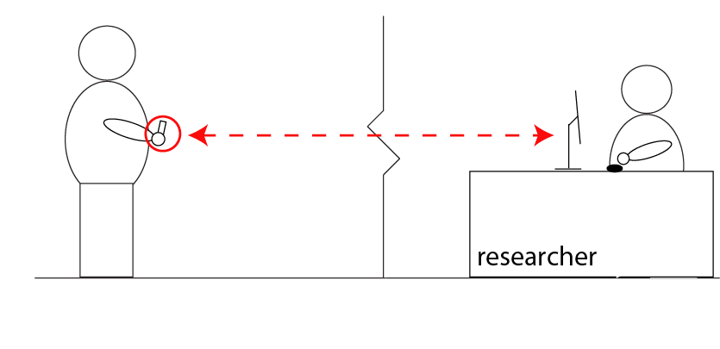
Typical experiment
SMS/MMS/XML
Experimenter
interface
Carter, Mankoff
Notes:
Fixed client also possible

Slide 46
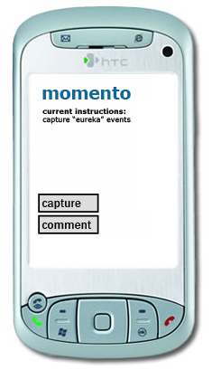
Quick access to real world data
Runs on mobile phones
No client install required
No coding required
Robust over days/weeks
Carter, Mankoff
Notes:
deploying a system that allows you to evaluate a concept (might include a rough prototype). Almost a probe --ver advanced

Slide 47
Mobile Client
Text file configuration
Study description
Capture
Audio, Bluetooth/GPS
Buttons
Remotely reconfigurable
Carter, Mankoff
Notes:
deploying a system that allows you to evaluate a concept (might include a rough prototype). Almost a probe --ver advanced

Slide 48
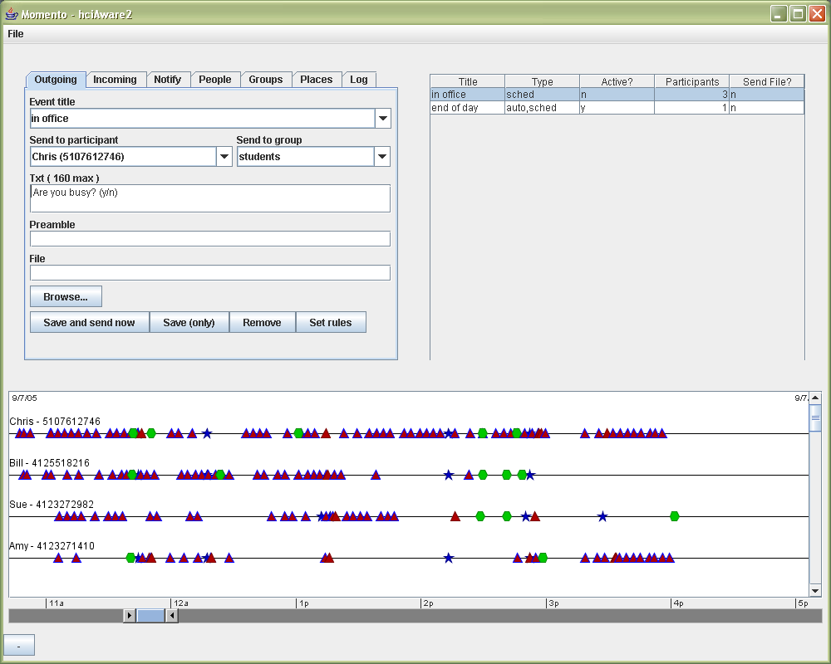
Easy ways to communicate with and study users
Easy setup for studies
Carter, Mankoff

Slide 49
Rule-based application design
If [cond and/or cond …]
Then send [content] to [recipient(s)]
Carter, Mankoff
Notes:
Experimenters can also use a simple rule system to automate feedback or to send notifications to participants throughout the day.

Slide 50
Rules
If [9:30AM]
Then send [“Remember to diary today”]
to [all]
Carter, Mankoff
Notes:
Experimenters can also use a simple rule system to automate feedback or to send notifications to participants throughout the day.

Slide 51
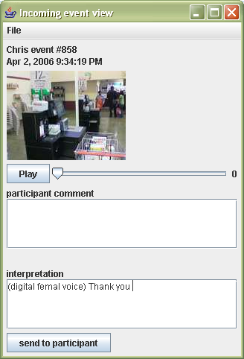
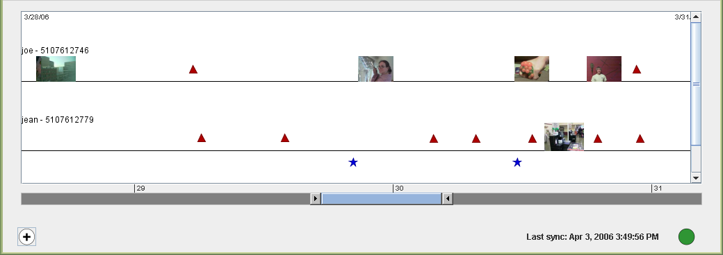
Support for Wizard-of-Oz
Easy setup for wizarding
Peripheral display for wizards
Carter, Mankoff
Notes:
Let’s you monitor and respond to incoming events

Slide 52
Supports many forms of need-gathering
Diary & ESM
WOz
Mixed methods
Context-based mobile games and services
Data collection
Carter, Mankoff
Notes:
With this infrastructure, Momento can support a broad array of studies.
…
For example, the rule system can also be used to implement location and proximity sensitive mobile-based games and other applications.

Slide 53
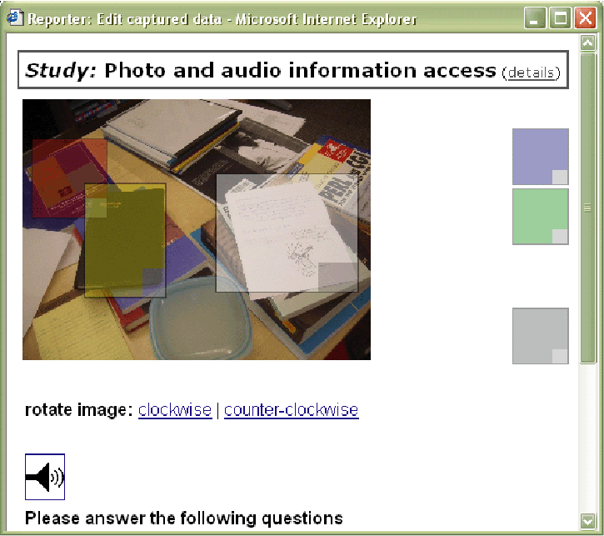
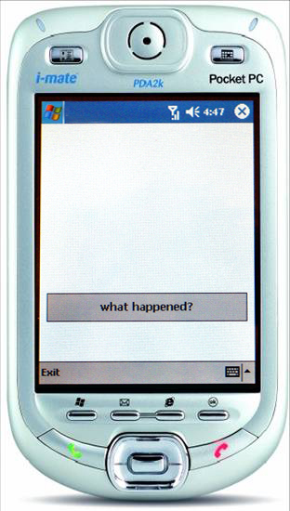
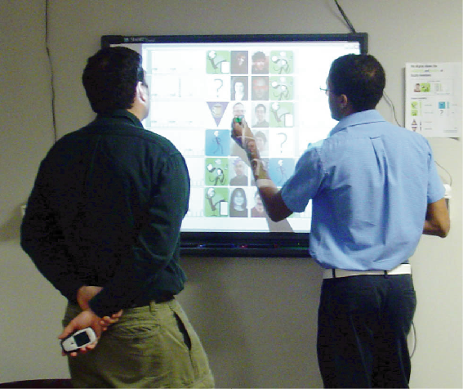
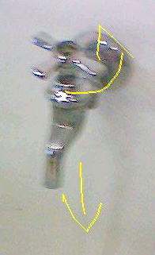
Validation
Informal learning
Scribe4Me
12 users
7 days
6 users
1-2 weeks
Photo Sketch
ESM study
24 users
1 day
14 users
2 months
Carter, Mankoff
Notes:
Usable/lowers floor:
“Developing” Scribe4Me: 3 configuration actions
Testing Scribe4Me: 3 configuration actions
Successfully supports evaluation
4 studies
2 weeks to 3 months in length
Varying levels of involvement by our team

Slide 54
Validation
Informal learning
Scribe4Me
12 users
7 days
6 users
1-2 weeks
Photo Sketch
ESM study
24 users
1 day
14 users
2 months
Carter, Mankoff
Notes:
Usable/lowers floor:
“Developing” Scribe4Me: 3 configuration actions
Testing Scribe4Me: 3 configuration actions
Successfully supports evaluation
4 studies
2 weeks to 3 months in length
Varying levels of involvement by our team

Slide 55
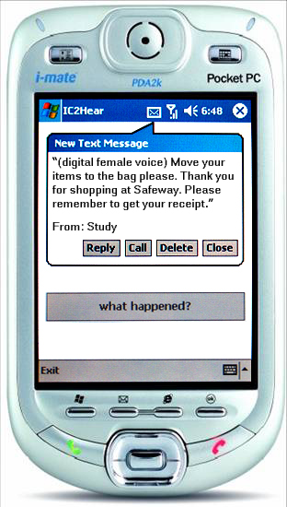
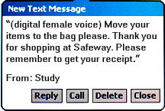
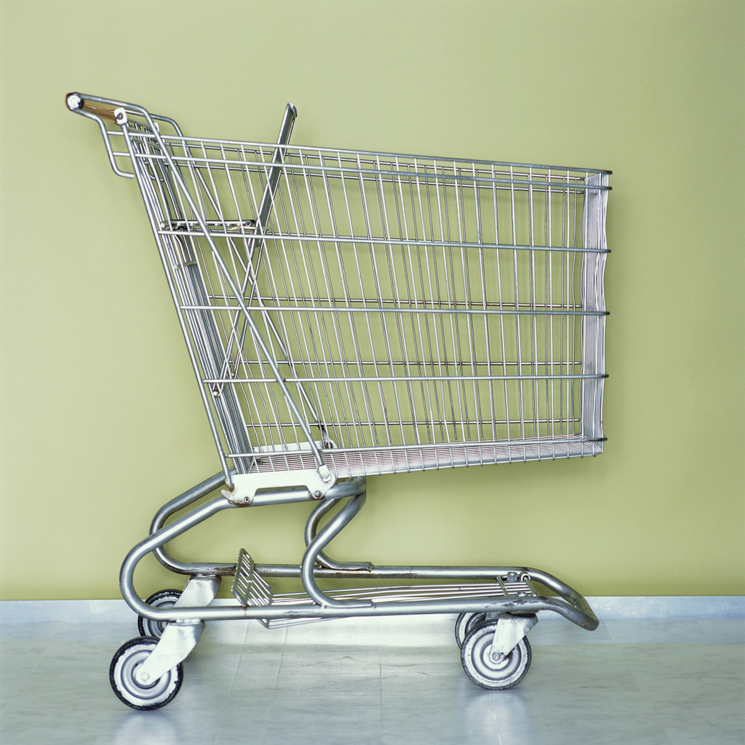
Scribe4Me System [Ubicomp’06]
Provides text transcriptions of the last 30 seconds of audio, upon user request
Conducted pilots and two week field study
Matthews, Carter, Mankoff
Notes:
Audio provides cues about
What’s going on around you
Problems (car, leaky faucet, etc.)
Alarms, alerts, the unexpected
Existing technology for the deaf is typically
Not mobile
Specific to a subset of sounds
Momento Mobile Client [Carter ‘06] to capture & transmit audio
Users asked to take a photo with requests
Sends two 15-second WAV files (8KHz mono, 115 kb each)
2-4 minutes to transmit via GPRS
Devices: I-mate PDA2K, Windows Mobile system

Slide 56
Scribe4Me Field Study
Participants 6, varied hearing
Method 2 week study, Daily email diary
Results
Many aspects of sound interesting
Speech
Gender and emotion
Environmental audio (info about volume; location; or id)
Historical information valuable
Mobile tools need to address informed consent
Matthews, Carter, Mankoff
Notes:
Study: [read]… Due to some scheduling problems, hardware issues, and network connectivity problems, users ended up completing between 7 and 15 days of the study (7, 8, 10, 13, 14, 15).
Participants – hearing: [read]… 3 had some hearing with aids or cochlear implants, which they used during the study.
Data - Diary: Users completed a daily email diary. We ask questions about each request, like why did you make the request, how useful was the response, and could it have been improved (where were you, which request today was most important to you and why)?
Requests: for each request, we have the audio, a photo, and a transcription. I am going to play for you an example of some audio requests we received, which will give you a sense for the quality and the types of situations people used the tool. I am avoiding audio that includes conversations for privacy reasons.
- grocery, airport

